Slide 1
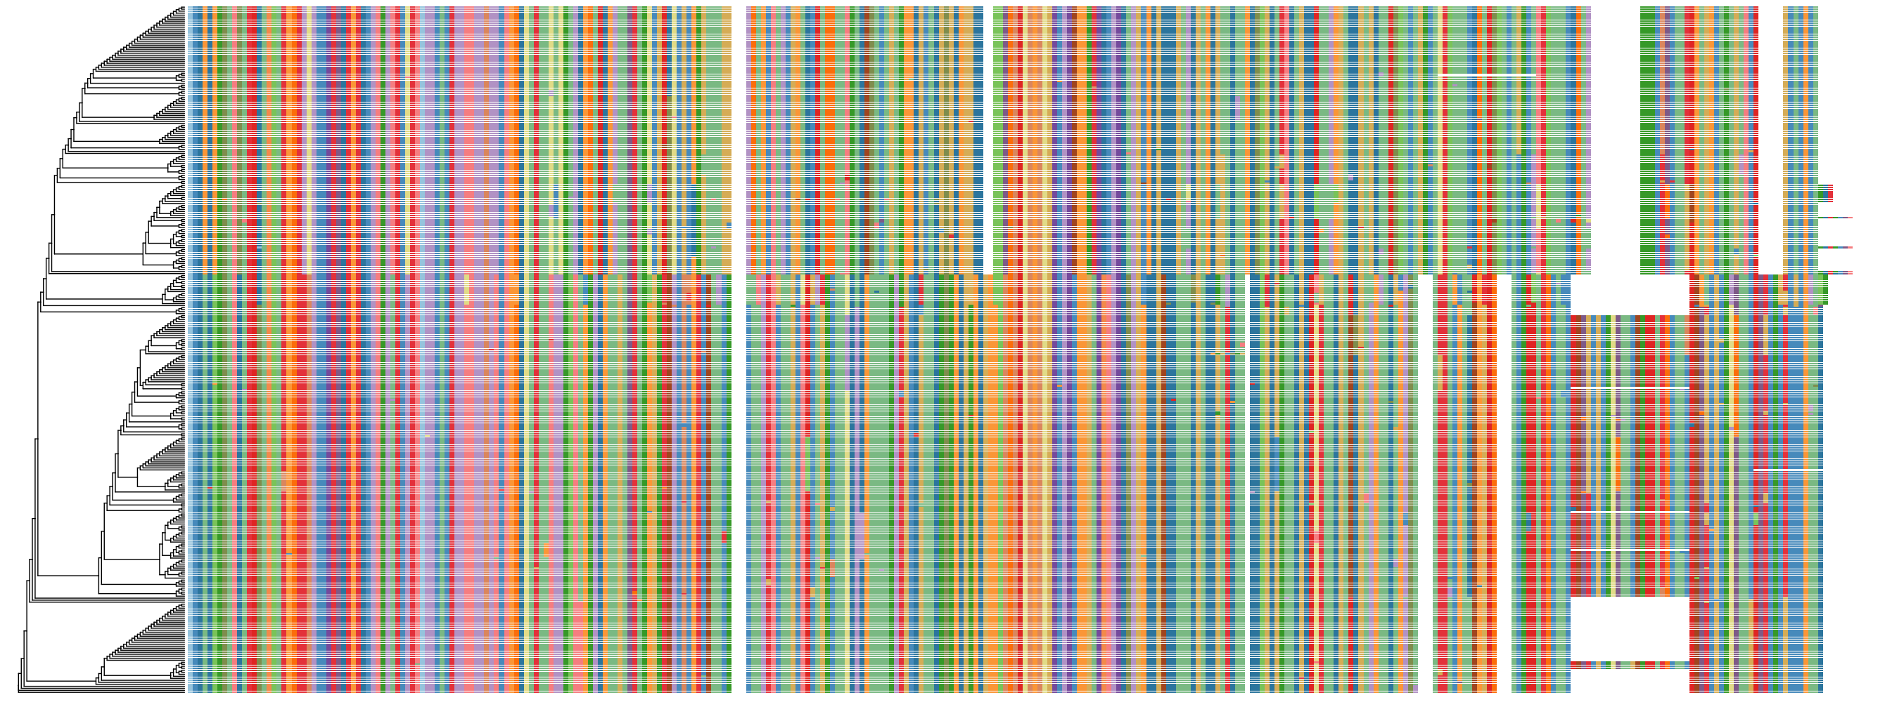

A
B
NS1
NS2
N
P
M
SH
G
F
M2.1/2
L
C
D
PC1 95% VE
PC2 3% VE

Slide 2
A
C
B
Protein Position
D
Protein Position
Protein Position

Slide 3
A
B
Notes:
Supplemental Figure. A. Association with persistent infection without clumping. Squared Pearson correlation coefficient (r²) with proxy SNP (126). During clumping, 126 only has cor with 221. No other SNPs are associated with phenotype. B. Squared Pearson correlation coefficient (r²) test set plot.

Slide 4
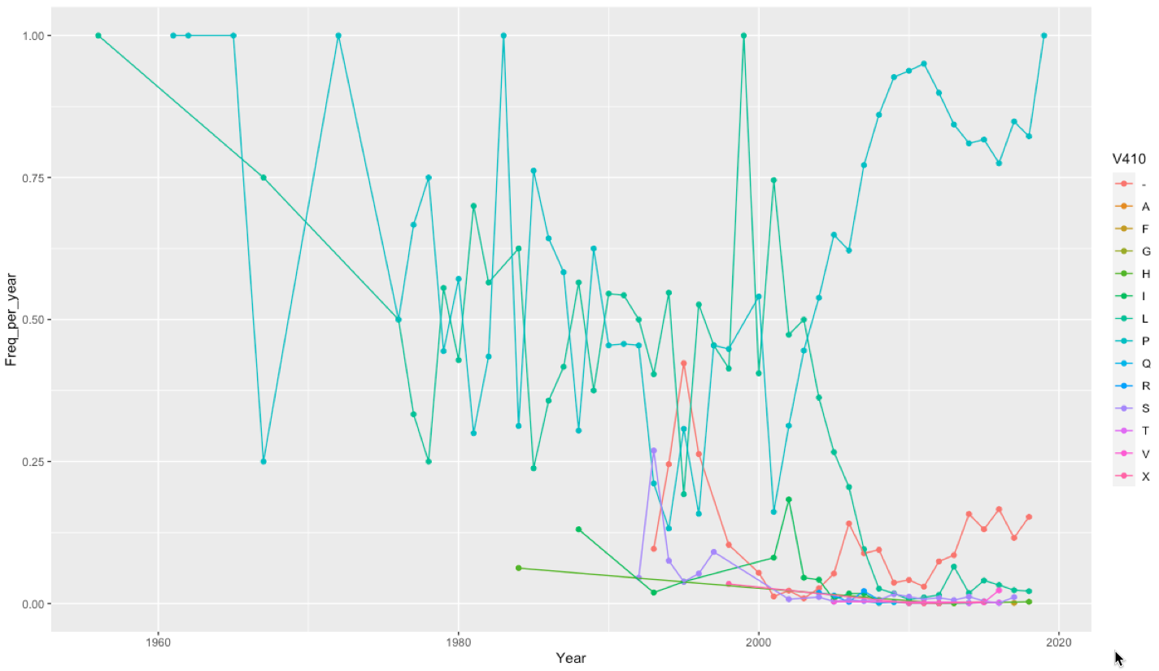
A
B
P
P
L
L
P
L
P
P
P
L
L
C
Protein position
Variance explained

Slide 5
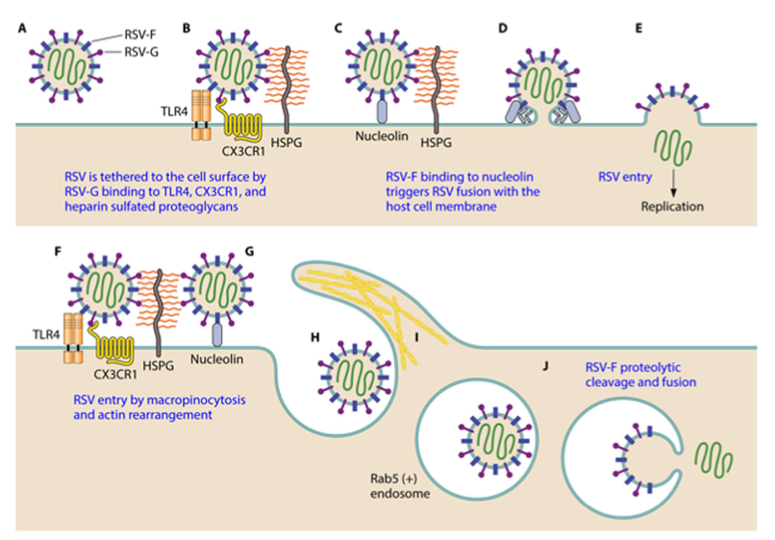
A
Figure. A.
Functional interpretation

Slide 6
Incomplete discussion points
RNA virus like HIV persist for life
Reservoirs within host?
environmental?
closer equator less seasonality.
virus may retreat to parts of the world where it can overseason; temp, humidity, etc.
Severity of second infection characterised URI/LRI and and score
This variant is in children that are less sick
Emergence?
Persist - variation within host
CT values go up when it is being cleared
first illness CT rarely lower than second CT = reducing virus.
Kenya - family sampling every 5 days (tropical medicine funded this, and South Africa Heather Zar)
“Why” is the variant present at low level in population.
Chronic disease.
Airway reprogramming.
Cleared virus may have less of influence than chronic.
Infants without RSV less likely to have asthma.
Infants infected go on to have blunted subsequent antiviral responses. • Chronic stimulation versus immune exhaustion?
Metabolism of airway epithelium, glycolytic pathways.
How would this mutation lead to persistence?
Epitope – Evasion – etc. Class I epitope – check the discussions with Jim.
Lets keep this as an open Q in the manuscript for others to add. (Suman, Jim Crow, McClullin(?) )
Selected in some backgrounds but not very fit?
Not increasing over time. Stable.
Acute and chronic resp mortidity to give it the spin for CID.
Note that not only the persistent have variants of interest, but many others also have this variants. Interesting pub on RSV clearance, including evidence of rebound
Interesting that we are having summer epidemic of RSV and others after COVID year.
Discussion of cytokines
Interesting that we are having summer epidemic of RSV and others after COVID year.

Slide 7
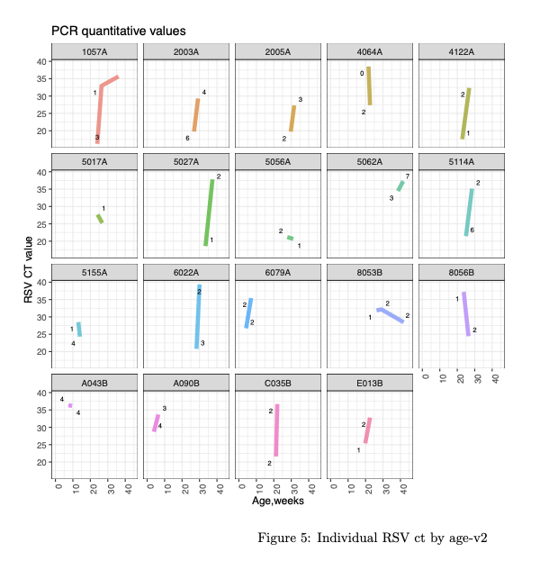
New supplementary figure is on page 10.
Figure legend: Each plot represents one of nineteen infants with persistent RSV infection. The x-axis represents the infant age at infection, the y-axis represents the RSV CT value. Each of the plotted datapoints include the respiratory severity score value calculated at the time of infection, a scale from 0-12 with higher numbers indicating more severe infection based on multiple clinical parameters.
(An alternative to this for the supplement is the figure on page 6.)
2. The new data for 4 variables for the table is on page 14 (the bottom 4 variables in the table on page 14). The following 4 variables need to be updated in that table:
Age of first RSV infection for those with persistent infection compared with single RSV infection
RSS at first RSV infection
Daycare attendance (new.oydaycare.var)
Siblings (efsib.bin)
3. If interested, there is a new table on pages 8-9 that includes the details of each of the illnesses, including the number of days between illnesses and the virus detected.
Should be a regression with
time, severity, and CT.
Plotting alone is not so useful.
Temp title Fig 2.

Slide 8
Amino acid position
Figure 1. Supplement Association with persistent infection without clumping

